Slide 1
Occupational Studies *Patisserie and Baking *Contemporary cuisine
Year 10 Options Week

Slide 2
What the course involves?
Occupational Studies is a two year course which is made up of two different modules.
Patisserie and Baking (50%)
Contemporary Cuisine (50%)
It is 100% coursework with both modules assessed through individual portfolios.
There is no external examination!

Slide 3
Portfolio Layout
For each module, the portfolio is divided into the following three sections.
AO1 (Knowledge Checks)
In this section, pupils will undertake a number of tasks that will assess their knowledge on their topic. This will be in the form of leaflets, presentations, and class tests.
AO2 (Evidence)
This section is comprised of photographs of student work during their assessed practical lessons and their score sheet.
AO3 (Evaluations)
This section is made up with evaluations from each assessed practical and a final overall evaluation.

Slide 4
What Will I Learn?
Health and Safety
Energy and Environmental Issues
Personal Hygiene/Food Hygiene
Practical Skills
Identifying Equipment
Presentation skills
Dietary Disorders
Healthy Alternative
Evaluation Techniques
Related Careers

Slide 5
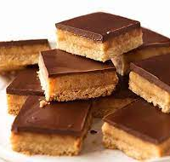
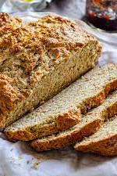
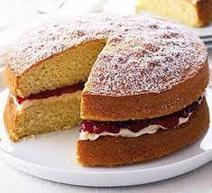
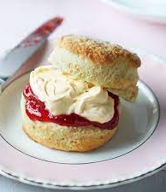
Year 11 Patisserie and Baking
This unit provides learners with some of the basic baking principles required by pastry chefs in the catering industry.
Pupils will create 4 dishes from each of the following topics:
Bread and Scones,
Cakes and Biscuits
Pastry.

Slide 6
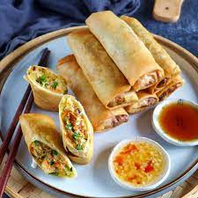
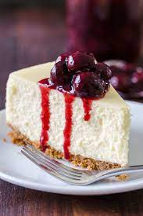
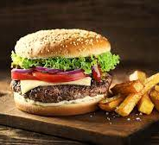
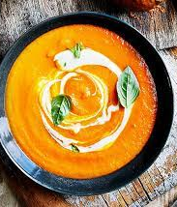
Year 12 Contemporary Cuisine
This unit provides learners with some of the basic cooking principles required by those in the catering industry.
Pupils will prepare and cook 4 dishes from the following topics:
Starters
Mains
Desserts

Slide 7
What Do We Do?
Runs alongside Food and Nutrition
2 double classes and 1 singe class a week
Cook almost every double class (Highly Practical)
Single class will be for theory work
Develop your cookery skills
Cooking Demos – LMC, Cake decorating Etc.

Slide 8
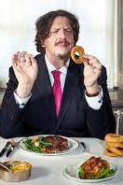
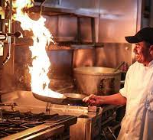
Careers
Baker
Food Producer
Street Vendor
Cake Decorator
Food Taster
Environmental Health Officer
Chef

